Slide 1
Frequency-dependent attenuation in fractional Helmholtz wave equations
State of progress
Samuel Rouah-Sayag

Slide 2
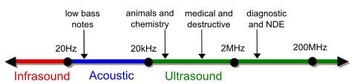
Ultrasound: general characteristics
Sound wave above hearing range (20 kHz).
Range: 20 kHz to more.
A wide range of application
Testing materials
Range finding (measuring distance)
Identification of objects
Imaging
Microscopy
Processing of materials
Picture Authoring: "Ultrasound range diagram" by Ultrasound_range_diagram.png: Original uploader was LightYear at en.wikipediaUltrasound_range_diagram_png_(sk).svg: Original uploader was LightYear at en.wikipediaderivative work: Coolth (talk) - Ultrasound_range_diagram.pngUltrasound_range_diagram_png_(sk).svg. Licensed under CC BY-SA 3.0 via Wikimedia Commons - https://commons.wikimedia.org/wiki/File:Ultrasound_range_diagram.svg#/media/File:Ultrasound_range_diagram.svg

Slide 3
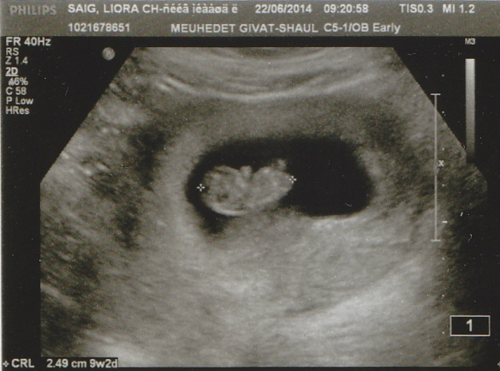
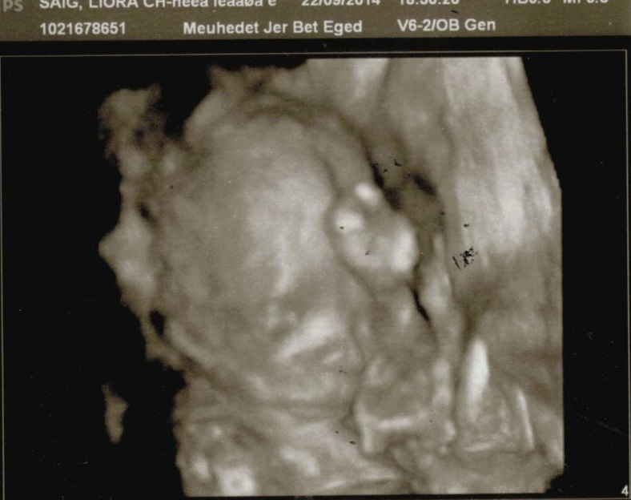
Medical ultrasound
Purpose of imaging.
Different modes (A, B, C, M, Doppler…).
Transducer active/passive
Steps to form an image:
Emission of a piezoelectric transducer.
Reception of the same transducer (time, intensity)
Time ≈ travel time (how deep)
Intensity ≈ brightness (how dense)
B-Mode (Brightness mode)
2D (B-Mode) and 3D picture of an embryo obtain with ultrasound (Michpala Meuhedet, Jerusalem, 2013).

Slide 4
Trade-off
Advantage
Ultrasound is cheap
(Medical) ultrasound is non destructive
It makes of it a tool of choice for sensitive diagnostics
Problem
Lack of precision due to the physics of measured phenomena and the targeted tissues.
Compromise in the calculation to obtain a human readable information (hard coded constant).
Type of machine and transducers (its geometry).
Possible solution TOMOGRAPHY
More complex. Require a better understanding and modelling of the underlying physics

Slide 5
The physics of the problem

Slide 6
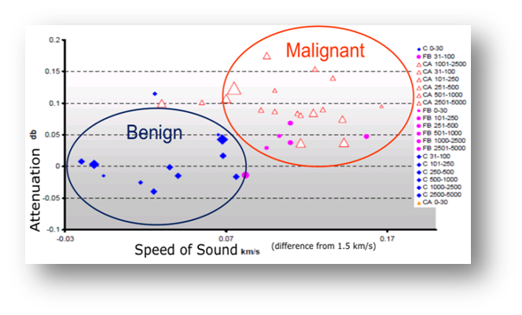
Speed of sound and power law attenuation
Resolution is obtained at high frequency
Depth is obtain a low frequency
Resolution and depth constitute a trade off
Attenuation is a constant not available in B-Mode
Figure 1: Detection and characterization of breast masses as a function of attenuation and speed of sound

Slide 7
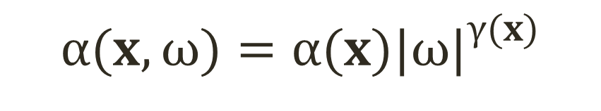
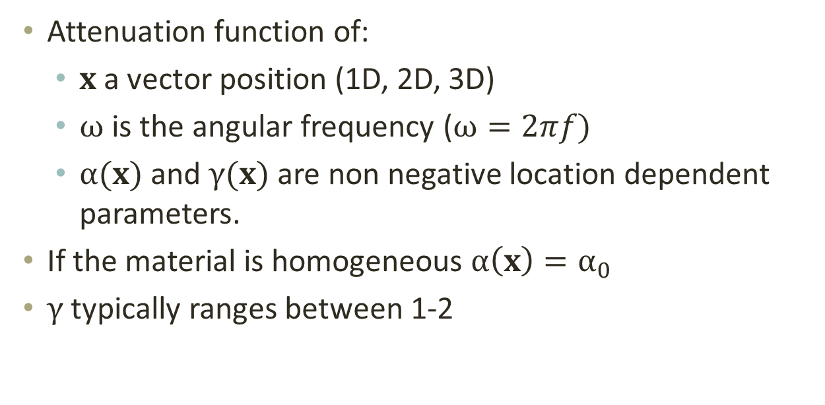
Speed of sound and power law attenuation
$$α(x, ω)=α(x){|ω|}^{γ(x)}$$
Attenuation function of:
$x$ a vector position (1D, 2D, 3D)
$ω$ is the angular frequency ($ω=2πf)$
$α(x)$ and $γ(x)$ are non negative location dependent parameters.
If the material is homogeneous $α\left(x\right)=α_{0}$
$γ$ typically ranges between 1-2

Slide 8
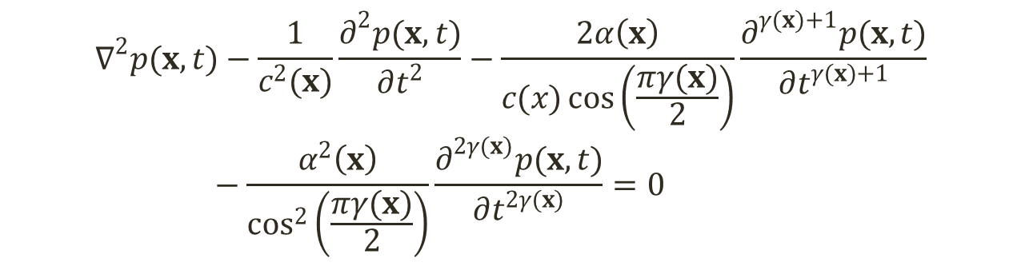
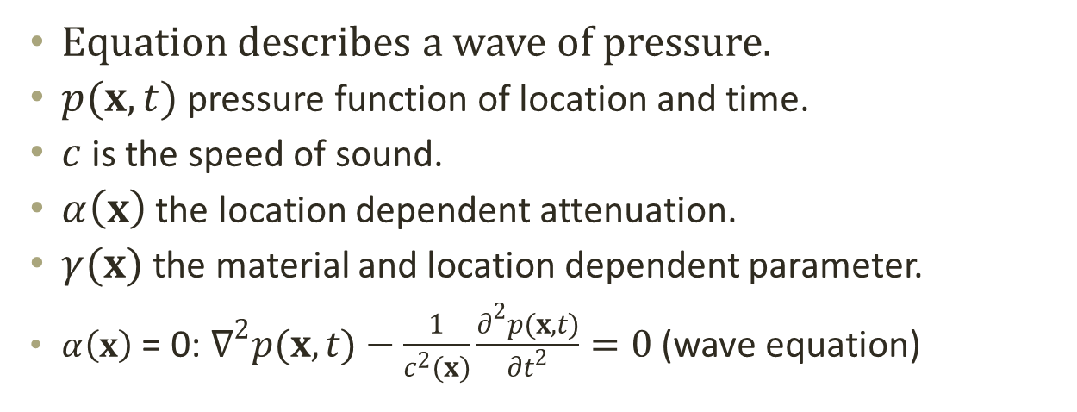
Fractional wave equation
$$∇^{2}p(x,t)−\frac{1}{c^{2}(x)}\frac{∂^{2}p(x,t)}{∂t^{2}}−\frac{2α\left(x\right)}{c(x)\cos\left(\frac{πγ(x)}{2}\right)}\frac{∂^{γ(x)+1}p(x,t)}{∂t^{γ(x)+1}}−\frac{α^{2}\left(x\right)}{\cos^{2}\left(\frac{πγ(x)}{2}\right)}\frac{∂^{2γ(x)}p(x,t)}{∂t^{2γ(x)}}=0$$
Equation describes a wave of pressure.
$p(x,t)$ pressure function of location and time.
$c$ is the speed of sound.
$α\left(x\right)$ the location dependent attenuation.
$γ(x)$ the material and location dependent parameter.
$α\left(x\right)$ = 0: $∇^{2}p(x,t)−\frac{1}{c^{2}(x)}\frac{∂^{2}p(x,t)}{∂t^{2}}=0$ (wave equation)

Slide 9
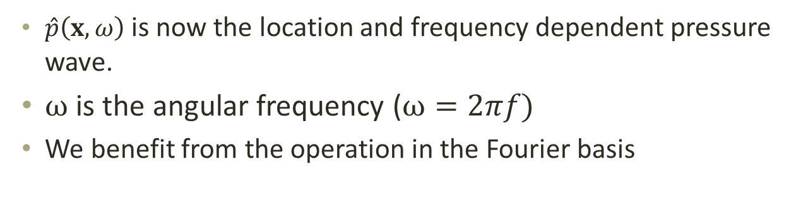
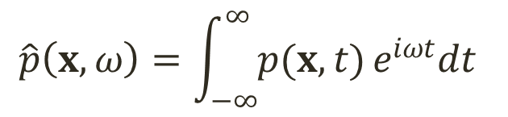
Fractional wave equation: the treatment
Fractional derivative equation are studied but the theory is rather complicated.
We switch the space-time basis with space-frequency with Fourier transform
$$\hat{p}\left(x,ω\right)=\int_{−∞}^{∞}{p(x,t)}e^{iωt}dt$$
$\hat{p}\left(x,ω\right)$ is now the location and frequency dependent pressure wave.
$ω$ is the angular frequency ($ω=2πf)$
We benefit from the operation in the Fourier basis

Slide 10
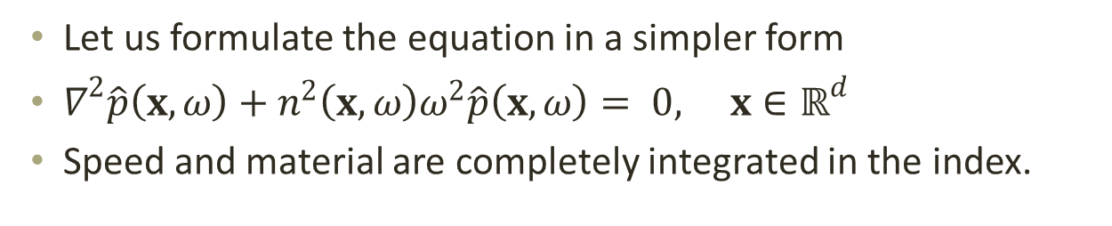
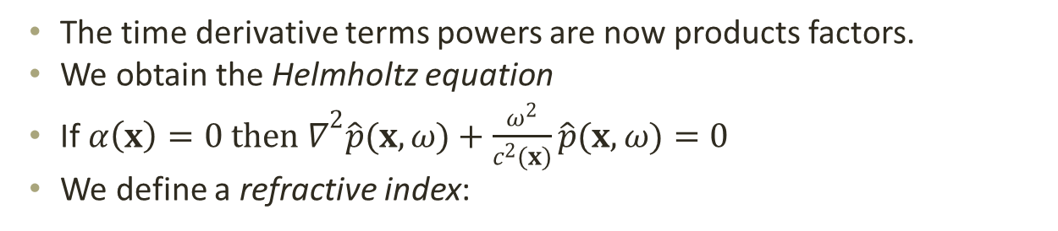
Helmholtz equation
$$∇^{2}\hat{p}(x,ω)+\left\{\frac{ω^{2}}{c^{2}(x)}−\frac{2α\left(x\right)}{c(x)\cos\left(\frac{πγ(x)}{2}\right)}{\left(−iω\right)}^{γ(x)+1}−\frac{α^{2}\left(x\right)}{\cos^{2}\left(\frac{πγ(x)}{2}\right)}{\left(−iω\right)}^{2γ(x)}\right\}\hat{p}(x,ω)=0$$
The time derivative terms powers are now products factors.
We obtain the Helmholtz equation
If ${α\left(x\right)=0 then ∇}^{2}\hat{p}(x,ω)+\frac{ω^{2}}{c^{2}(x)}\hat{p}(x,ω)=0$
We define a refractive index:
$$n^{2}\left(x,ω\right)≡\frac{1}{c^{2}\left(x\right)}−\frac{2α\left(x\right)}{c\left(x\right)\cos\left(\frac{πγ\left(x\right)}{2}\right)}{\left(−i\right)}^{γ\left(x\right)+1}ω^{γ\left(x\right)−1}−\frac{α^{2}\left(x\right)}{\cos^{2}\left(\frac{πγ(x)}{2}\right)}{\left(−i\right)}^{2γ(x)}ω^{2(γ(x)−1)}$$
Let us formulate the equation in a simpler form
$∇^{2}\hat{p}\left(x,ω\right)+n^{2}\left(x,ω\right)ω^{2}\hat{p}\left(x,ω\right)= 0, x∈ℝ^{d}$
Speed and material are completely integrated in the index.

Slide 11
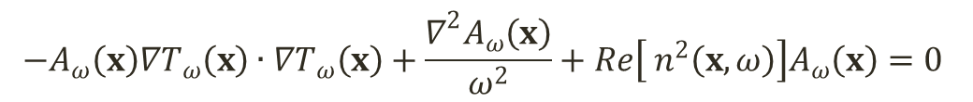
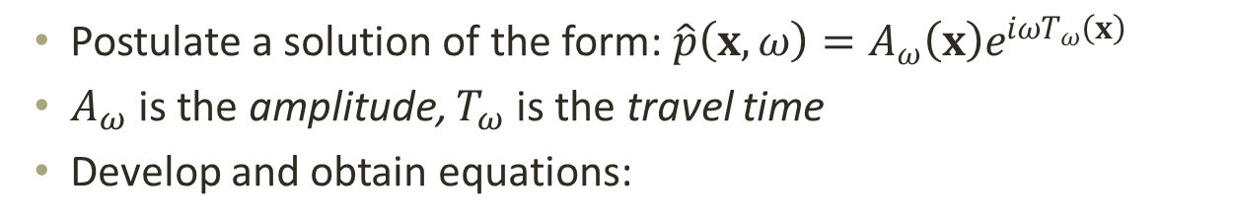
Helmholtz equation: the treatment
Postulate a solution of the form: $\hat{p}\left(x,ω\right)=A_{ω}\left(x\right)e^{iωT_{ω}\left(x\right)}$
$A_{ω}$ is the amplitude, $T_{ω}$ is the travel time
Develop and obtain equations:
$$−A_{ω}\left(x\right)∇T_{ω}\left(x\right)∙∇T_{ω}\left(x\right)+\frac{∇^{2}A_{ω}\left(x\right)}{ω^{2}}+Re\left[ n^{2}\left(x,ω\right)\right]A_{ω}\left(x\right)=0$$
$$A_{ω}\left(x\right)∇^{2}T_{ω}\left(x\right)+2∇A_{ω}\left(x\right)∙∇T_{ω}\left(x\right)+Im \left[n^{2}\left(x,ω\right)\right]ωA_{ω}\left(x\right)=0$$
First possibility: highly oscillating system
Second possibility: low to averagely oscillating system

Slide 12
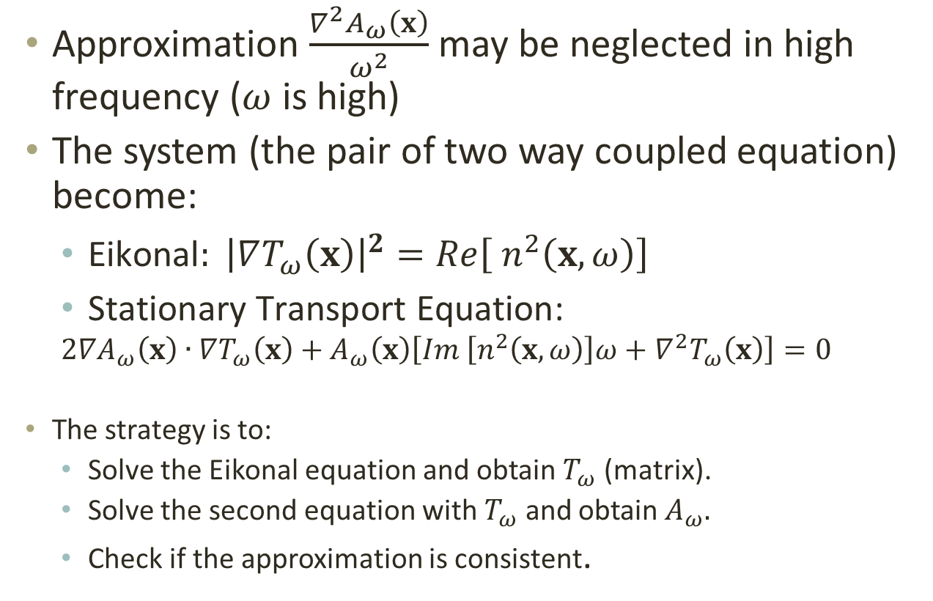
Highly oscillating system
Approximation $\frac{∇^{2}A_{ω}\left(x\right)}{ω^{2}}$ may be neglected in high frequency ($ω$ is high)
The system (the pair of two way coupled equation) become:
$\text{Eikonal}: {\left|∇T_{ω}\left(x\right)\right|}^{2}=Re\left[ n^{2}\left(x,ω\right)\right]$
$\text{Stationary} \text{Transport} \text{Equation}\text{: }$
$$2∇A_{ω}\left(x\right)∙∇T_{ω}\left(x\right)+A_{ω}\left(x\right)\left[Im \left[n^{2}\left(x,ω\right)\right]ω+∇^{2}T_{ω}\left(x\right)\right]=0$$
The strategy is to:
Solve the Eikonal equation and obtain $T_{ω}$ (matrix).
Solve the second equation with $T_{ω}$ and obtain $A_{ω}.$
Check if the approximation is consistent.

Slide 13
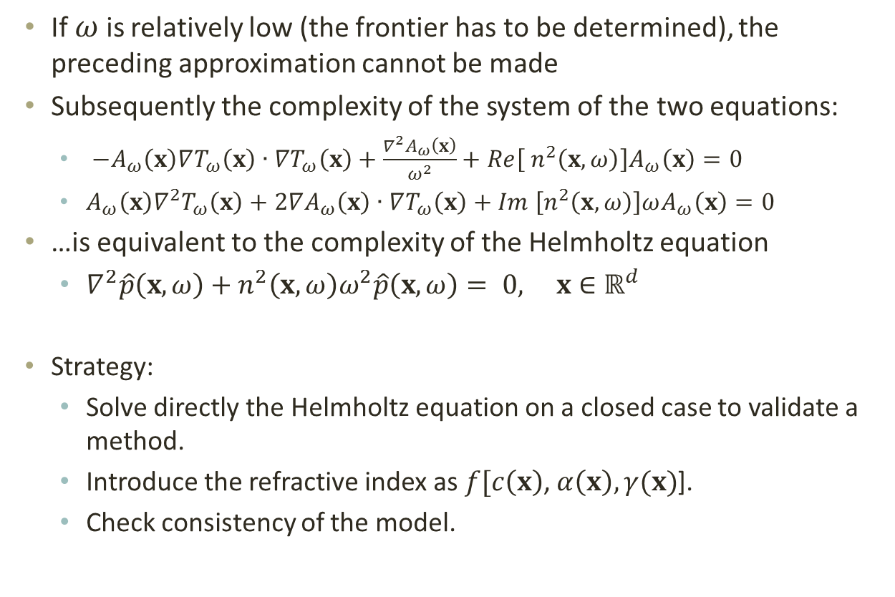
Low to averagely oscillating system
If $ω$ is relatively low (the frontier has to be determined), the preceding approximation cannot be made
Subsequently the complexity of the system of the two equations:
$−A_{ω}\left(x\right)∇T_{ω}\left(x\right)∙∇T_{ω}\left(x\right)+\frac{∇^{2}A_{ω}\left(x\right)}{ω^{2}}+Re\left[ n^{2}\left(x,ω\right)\right]A_{ω}\left(x\right)=0$
$A_{ω}\left(x\right)∇^{2}T_{ω}\left(x\right)+2∇A_{ω}\left(x\right)∙∇T_{ω}\left(x\right)+Im \left[n^{2}\left(x,ω\right)\right]ωA_{ω}\left(x\right)=0$
…is equivalent to the complexity of the Helmholtz equation
$∇^{2}\hat{p}\left(x,ω\right)+n^{2}\left(x,ω\right)ω^{2}\hat{p}\left(x,ω\right)= 0, x∈ℝ^{d}$
Strategy:
Solve directly the Helmholtz equation on a closed case to validate a method.
Introduce the refractive index as $f[c\left(x\right)$, $α\left(x\right),γ(x)$].
Check consistency of the model.

Slide 14
Project goal: tackle low and intermediate frequency
Explore and compare several methods to solve the forward problem.
High frequency hypothesis: ray approximation to the wave front propagation. Solve the Transport Equation coupled to the Eikonal equation - one-way-coupling.
The ultimate method and goal of the project is the solution of the full-wave Helmholtz equation.
Build a tool.
Conduct numerical simulations to evaluate the results.

Slide 15
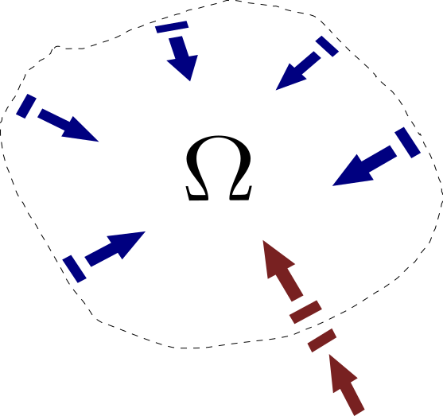
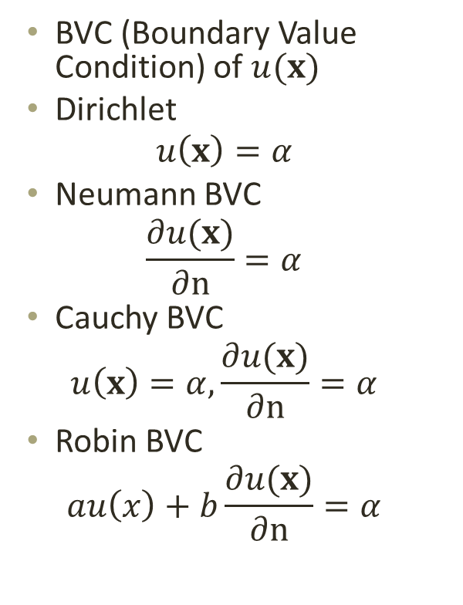
BVP: Boundary Value Problem
BVC (Boundary Value Condition) of $u(x)$
Dirichlet
$$u\left(x\right)=α$$
Neumann BVC
$$\frac{∂u(x)}{∂n}=α$$
Cauchy BVC
$$u\left(x\right)=α, \frac{∂u(x)}{∂n}=α$$
Robin BVC
$$au\left(x\right)+b\frac{∂u(x)}{∂n}=α$$

Slide 16
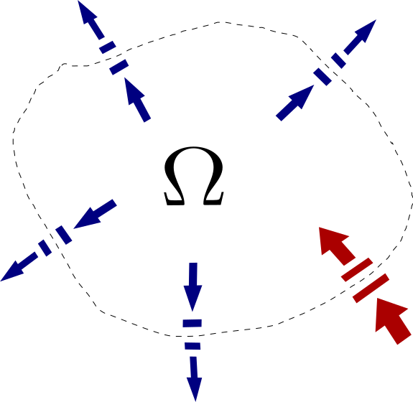
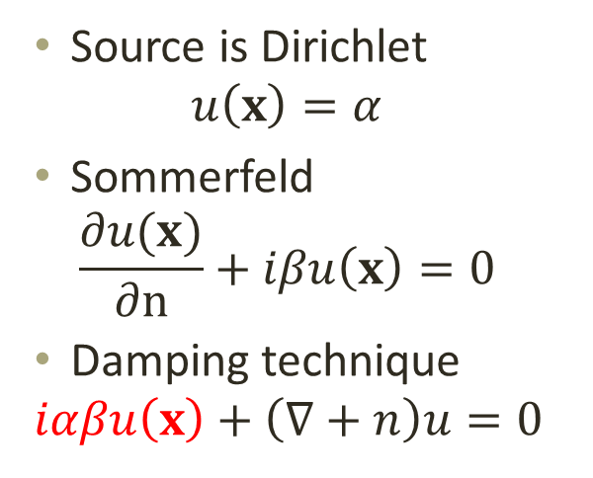
BVP: Boundary Value Problem
Source is Dirichlet
$$u\left(x\right)=α$$
Sommerfeld
$$\frac{∂u(x)}{∂n}+iβu\left(x\right)=0$$
Damping technique
$$iαβu\left(x\right)+\left(∇+n\right)u=0$$

Slide 17
Available methods and the chosen method

Slide 18
Finite Differences Method (FDM)
The operator (the equation) and its parameters are known.
We define a region (possibly time range) on it we want to solve the equation.
We seek an approximation of the operator by “replacing the derivatives in the differential equation by finite difference approximation” (Leveques, 2007).
There is approximation as also error.
The replacing formulas is found according to the desired order of precision thanks to Taylor theorem.
Different methods exist that fit to the type of operator that is dealt with: parabolic, hyperbolic, elliptic.

Slide 19
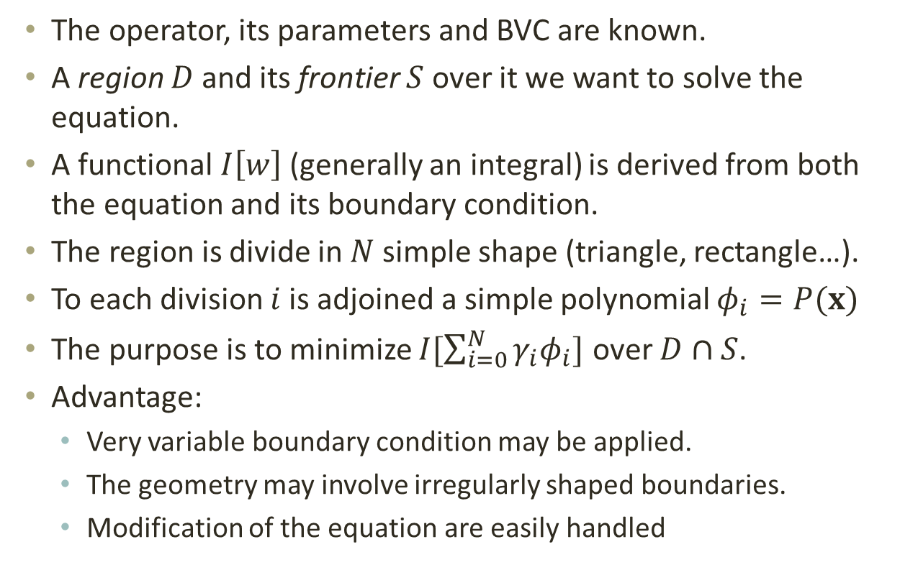
Finite elements method (FEM)
The operator, its parameters and BVC are known.
A region $D$ and its frontier $S$ over it we want to solve the equation.
A functional $I\left[w\right]$ (generally an integral) is derived from both the equation and its boundary condition.
The region is divide in $N$ simple shape (triangle, rectangle…).
To each division $i$ is adjoined a simple polynomial $φ_{i}=P(x)$
The purpose is to minimize $I[\sum_{i=0}^{N}{γ_{i}φ_{i}}]$ over $D∩S$.
Advantage:
Very variable boundary condition may be applied.
The geometry may involve irregularly shaped boundaries.
Modification of the equation are easily handled

Slide 20
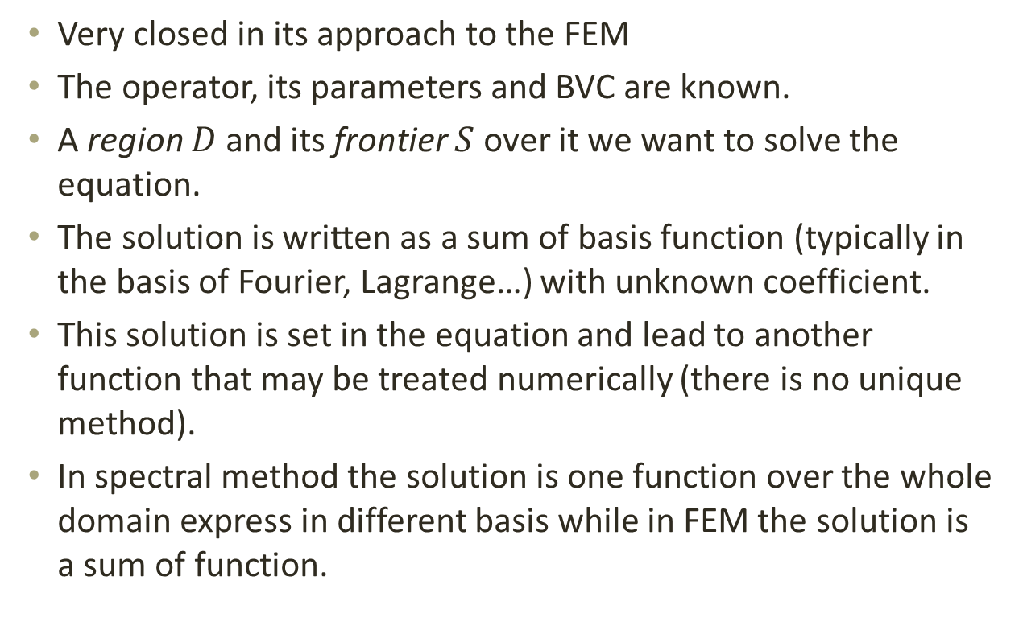
Spectral Method (SM)
Very closed in its approach to the FEM
The operator, its parameters and BVC are known.
A region $D$ and its frontier $S$ over it we want to solve the equation.
The solution is written as a sum of basis function (typically in the basis of Fourier, Lagrange…) with unknown coefficient.
This solution is set in the equation and lead to another function that may be treated numerically (there is no unique method).
In spectral method the solution is one function over the whole domain express in different basis while in FEM the solution is a sum of function.

Slide 21
Study of the FDM (Finite Difference Method)
Reference:
LeVeque R J., Finite Difference Methods for Ordinary and Partial Differential Equations. Philadelphia: Society for Industrial and Applied Mathematics (SIAM), 2007.
Burden R L. and Faire J D, Numerical Analysis, 9th ed.: Brooks/Cole, 2010.
S C Chapra and R P Canale, Numerical Methods For Engineers, Sixth Edition ed., Mac Graw Hill, Ed., 2010

Slide 22
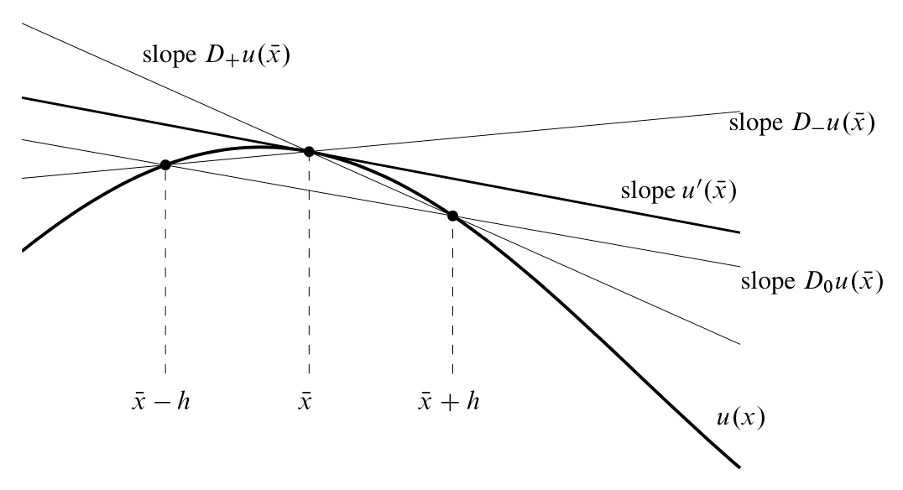
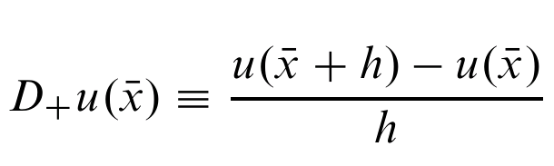
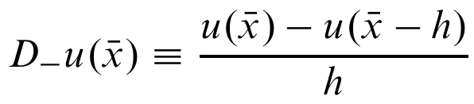
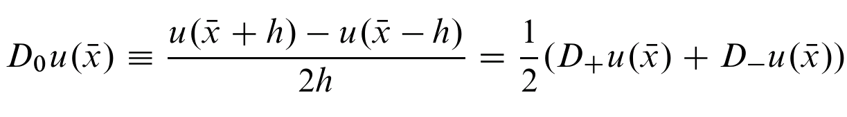
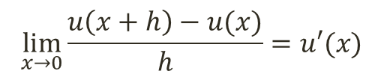
From the derivation
$$⁡\lim_{x→0}{\frac{u\left(x+h\right)−u(x)}{h}=u′(x)}$$
Illustration: Finite Difference Methods for Ordinary and Partial Differential Equations, Leveque, 2007.

Slide 23
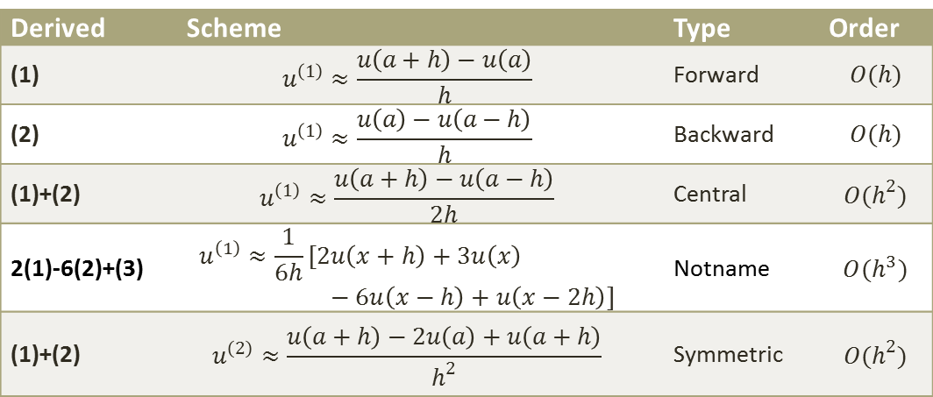

From Taylor
Taylor Theorem (1712 !)
$u\left(a+h\right)=u\left(a\right)+ \frac{u^{\left(1\right)}\left(a\right)}{1!}h+ \frac{u^{\left(2\right)}\left(a\right)}{2!}h^{2}+ \frac{u^{\left(3\right)}\left(a\right)}{3!}h^{3}+O(h^{4})$ (1)
$u\left(a−h\right)=u\left(a\right)−u^{\left(1\right)}\left(a\right)h+ \frac{1}{2}u^{\left(2\right)}\left(a\right)h^{2}− \frac{1}{6}u^{\left(3\right)}\left(a\right)h^{3}+O(h^{4})$ (2)
$u\left(a−2h\right)=u\left(a\right)−u^{\left(1\right)}\left(a\right)2h+2u^{\left(2\right)}\left(a\right)h^{2}− \frac{4}{3}u^{\left(3\right)}\left(a\right)h^{3}+O(h^{4})$ (3)
Derived | Scheme | Type | Order
(1) | $$u^{\left(1\right)}≈\frac{u\left(a+h\right)−u\left(a\right)}{h}$$ | Forward | $$O(h)$$
(2) | $$u^{\left(1\right)}≈\frac{u\left(a\right)−u\left(a−h\right)}{h}$$ | Backward | $$O(h)$$
(1)+(2) | $$u^{\left(1\right)}≈\frac{u\left(a+h\right)−u\left(a−h\right)}{2h}$$ | Central | $$O(h^{2})$$
2(1)-6(2)+(3) | $$u^{\left(1\right)}≈\frac{1}{6h}[2u\left(x+h\right)+3u\left(x\right)−6u\left(x−h\right)+u\left(x−2h\right)]$$ | Notname | $$O(h^{3})$$
(1)+(2) | $$u^{\left(2\right)}≈\frac{u\left(a+h\right)−2u\left(a\right)+u\left(a+h\right)}{h^{2}}$$ | Symmetric | $$O(h^{2})$$

Slide 24
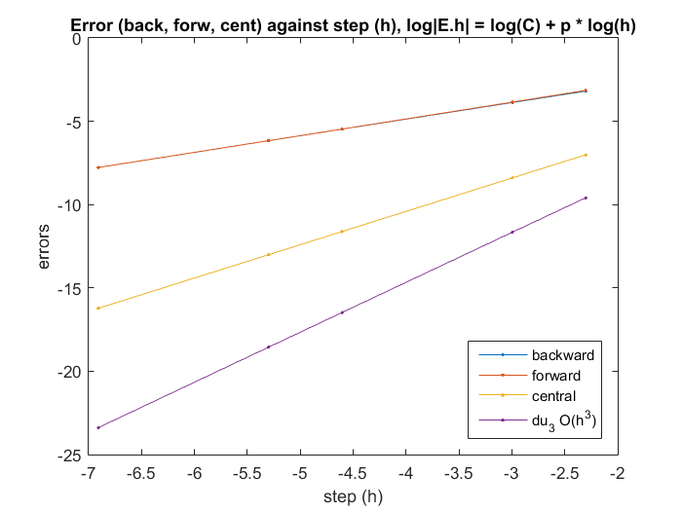

Error
Example: $u\left(x\right)=\sin\left(x\right)$, and we want an approximation a $x=1$ of the first derivative ($u′\left(1\right)=\cos\left(1\right)=0.540302305868140$).
'h' 'Back Err' 'Forw Err'
[1.0000e-01] [-4.1138e-02] [4.2939e-02]
[5.0000e-02] [-2.0807e-02] [2.1257e-02]
[1.0000e-02] [-4.1983e-03] [4.2163e-03]
[5.0000e-03] [-2.1014e-03] [2.1059e-03]
[1.0000e-03] [-4.2065e-04] [4.2083e-04]
'Cent Err' 'du_3_err'
[9.0005e-04] [-6.8207e-05]
[2.2510e-04] [-8.6491e-06]
[9.0050e-06] [-6.9941e-08]
[2.2513e-06] [-8.7540e-09]
[9.0050e-08] [-6.9979e-11]

Slide 25
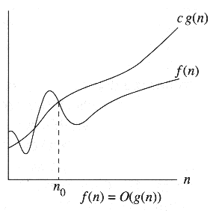
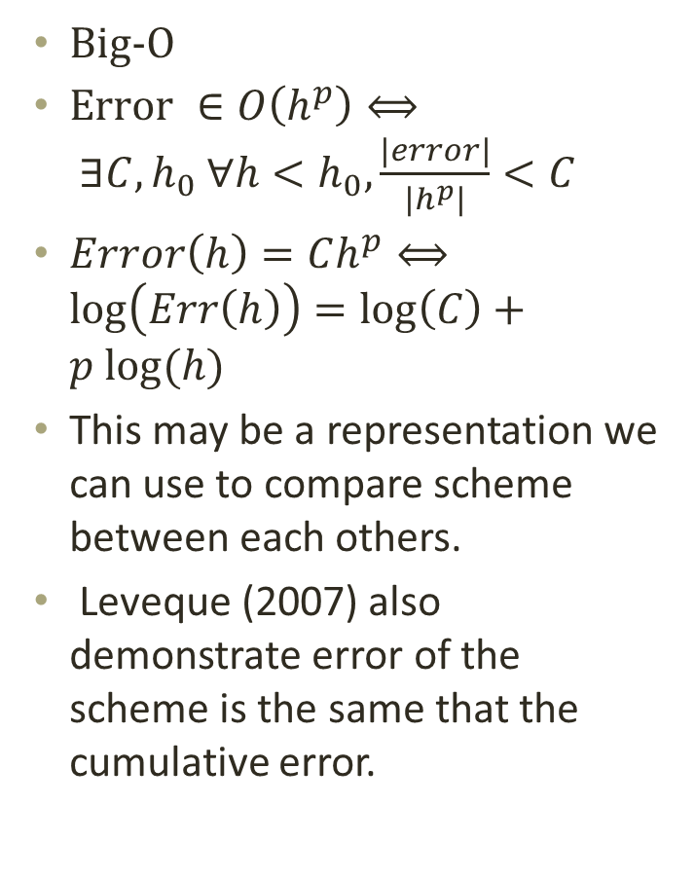
Errors: truncation
Big-O
$Error ∈O\left(h^{p}\right)⟺ ∃C, h_{0} ∀h<h_{0},\frac{\left|error\right|}{\left|h^{p}\right|}<C$
$Error\left(h\right)=Ch^{p}⟺\log\left(Err\left(h\right)\right)=\log\left(C\right)+p log⁡(h)$
This may be a representation we can use to compare scheme between each others.
Leveque (2007) also demonstrate error of the scheme is the same that the cumulative error.

Slide 26
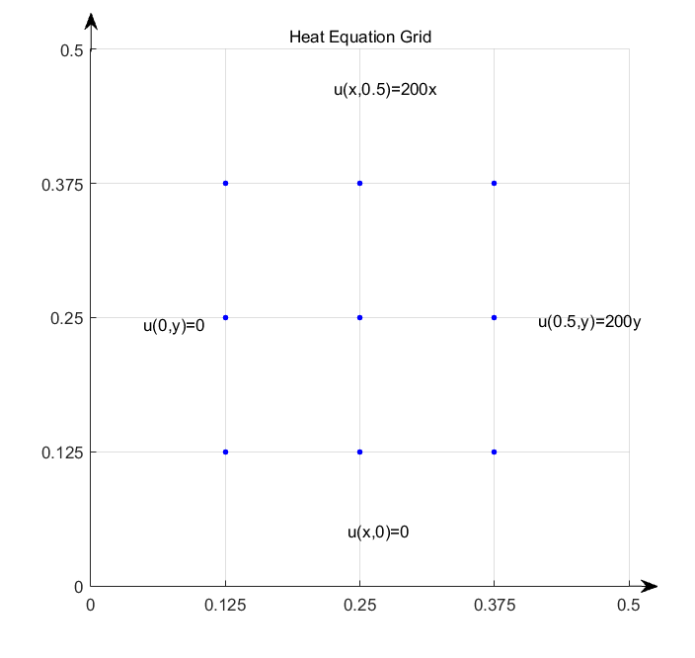

PDE Poisson
Elliptic PDE (stationary) so is Helmholtz
$Ω=[0 0.5]×$ $\left[0 0.5\right]$ with $h=0,125$
$$\left\{\begin{aligned}∇^{2}u(x,y)≡\frac{∂^{2}u(x,y)}{∂x^{2}}+\frac{∂^{2}u(x,y)}{∂y^{2}}=f(x,y) \\ u\left(x,y\right)=g\left(x,y\right)\end{aligned}\right.$$
$$\frac{u\left(x_{i+1},y_{j}\right)−2u\left(x_{i},y_{j}\right)+u\left(x_{i−1},y_{j}\right)}{h^{2}}+$$
$$\frac{u\left(x_{i},y_{j+1}\right)−2u\left(x_{i},y_{j}\right)+u\left(x_{i},y_{j+1}\right)}{h^{2}}$$
$$=f\left(x_{i},y_{j}\right)+ \frac{h^{2}}{12}\frac{∂^{4}u}{∂x^{4}}+\frac{h^{2}}{12}\frac{∂^{4}u}{∂x^{4}}$$
$$\left\{\begin{aligned}4u_{i,j}−u_{i+1,j}+u_{i−1,j}−u_{i,j+1}+u_{i,j−1} \\ =−h^{2}f\left(x_{i},y_{j}\right) \\ u_{0j}=g\left(x_{0},y_{j}\right), u_{nj}=g\left(x_{n},y_{j}\right), \\ u_{i0}=g\left(x_{i},y_{0}\right), u_{im}=g\left(x_{i},y_{m}\right)\end{aligned}\right.$$

Slide 27
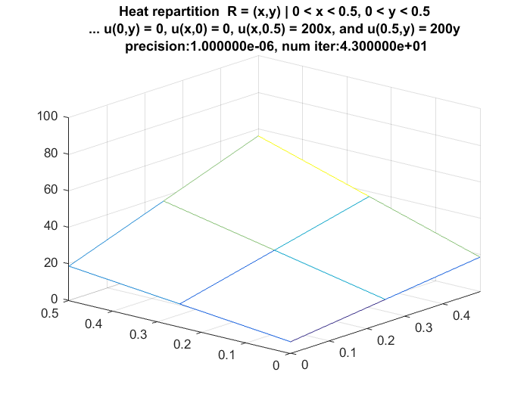
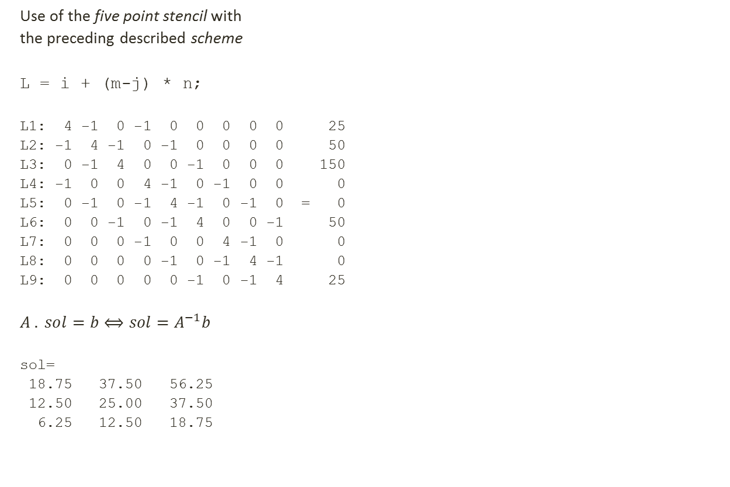
Results
Use of the five point stencil with
the preceding described scheme
L = i + (m-j) * n;
L1: 4 -1 0 -1 0 0 0 0 0 25
L2: -1 4 -1 0 -1 0 0 0 0 50
L3: 0 -1 4 0 0 -1 0 0 0 150
L4: -1 0 0 4 -1 0 -1 0 0 0
L5: 0 -1 0 -1 4 -1 0 -1 0 = 0
L6: 0 0 -1 0 -1 4 0 0 -1 50
L7: 0 0 0 -1 0 0 4 -1 0 0
L8: 0 0 0 0 -1 0 -1 4 -1 0
L9: 0 0 0 0 0 -1 0 -1 4 25
$$A . sol=b⟺sol=A^{−1}b$$
sol=
18.75 37.50 56.25
12.50 25.00 37.50
6.25 12.50 18.75

Slide 28
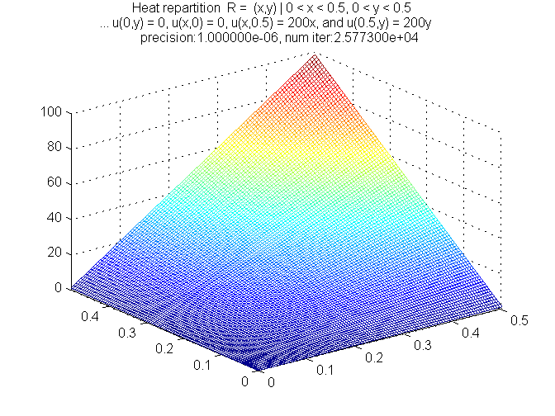

Poisson (suite)
If $h=0.01$ the result is more precise…

Slide 29
Exact finite difference scheme for the Helmholtz equation
Study of the article:
Wong Yau Shu and Li Guangrui, Exact Finite Difference Schemes for Solving Helmholtz Equation at Any Wavenumber, Institute for Scientific Computing and Information, Ed.: International Journal of Numerical Analysis and Modeling, 2001, vol. 2.
Hegedus G. and Kuczmann M., Calculation of the Solution of Two-Dimensional Helmholtz Equation.: Acta Technica Jaurinensis, 2010, vol. 1.

Slide 30
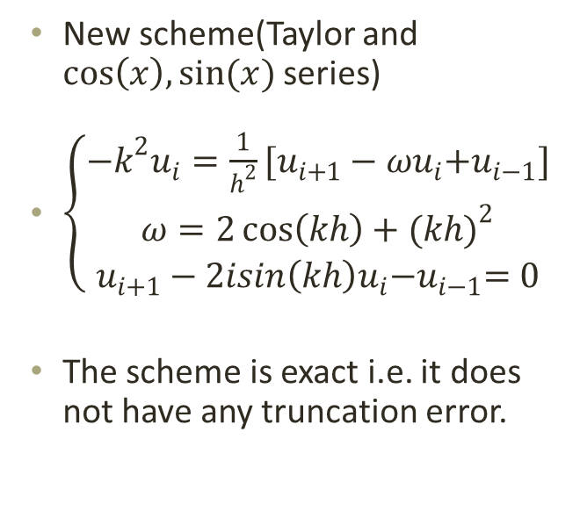

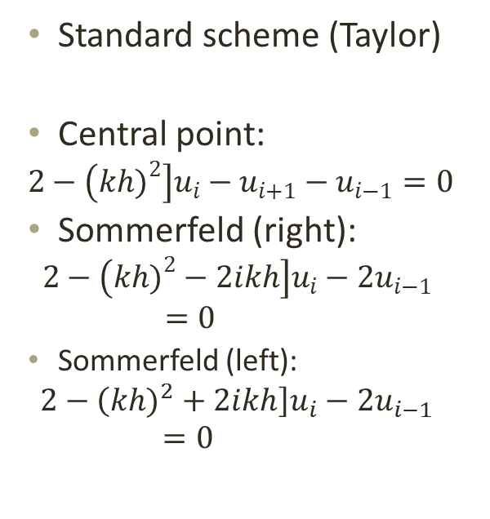
1D problem
$$\left\{\begin{aligned}∇^{2}u(x)+k^{2}u(x)=0, xε[a,b] \\ \frac{∂u(x)}{∂x}=iku(x) (Sommerfeld) \\ U\left(a\right)=α (Dirichlet)\end{aligned}\right.$$
Standard scheme (Taylor)
Central point:
$$2−\left({kh)}^{2}\right]u_{i}−u_{i+1}−u_{i−1}=0$$
Sommerfeld (right):
$$2−\left({kh)}^{2}−2ikh\right]u_{i}−2u_{i−1}=0$$
Sommerfeld (left):
$$2−\left({kh)}^{2}+2ikh\right]u_{i}−2u_{i−1}=0$$
New scheme(Taylor and $cos\left(x\right), sin⁡(x)$ series)
$\left\{\begin{aligned}−k^{2}u_{i}=\frac{1}{h^{2}}[u_{i+1}−ωu_{i}{+u}_{i−1}] \\ ω=2\cos\left(kh\right)+{(kh)}^{2} \\ u_{i+1}−2isin\left(kh\right)u_{i}{−u}_{i−1}=0\end{aligned}\right.$
The scheme is exact i.e. it does not have any truncation error.

Slide 31
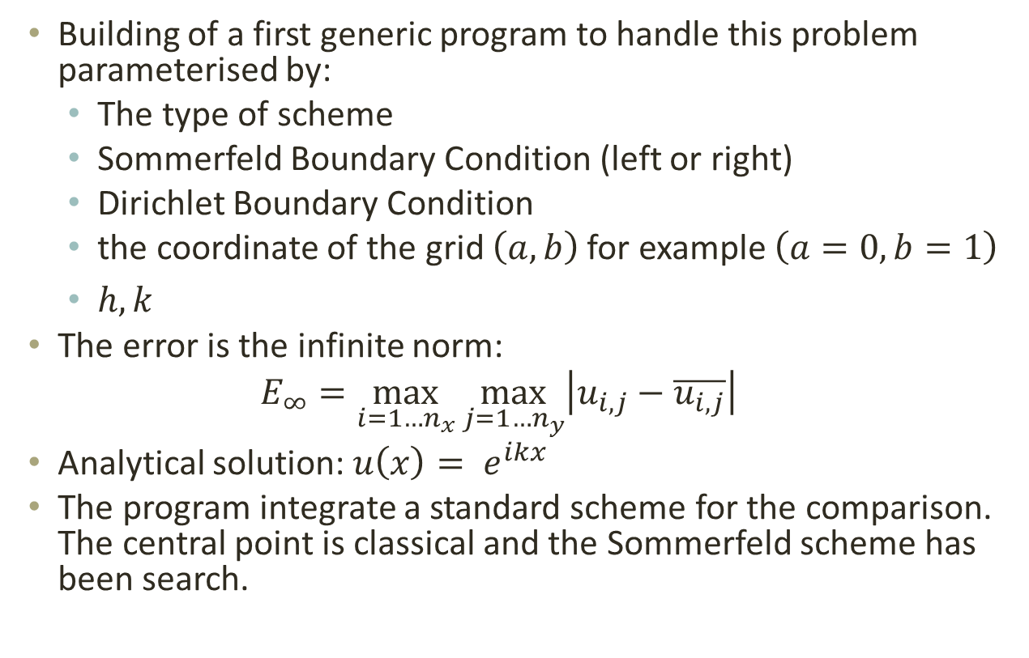
Program
Building of a first generic program to handle this problem parameterised by:
The type of scheme
Sommerfeld Boundary Condition (left or right)
Dirichlet Boundary Condition
the coordinate of the grid $\left(a, b\right)$ for example $\left(a=0, b=1\right)$
$h, k$
The error is the infinite norm:
$$E_{∞}=\max_{i=1…n_{x}}{\max_{j=1…n_{y}}\left|u_{i,j}−\overline{u_{i,j}}\right|}$$
Analytical solution: $u\left(x\right)= e^{ikx}$
The program integrate a standard scheme for the comparison. The central point is classical and the Sommerfeld scheme has been search.

Slide 32
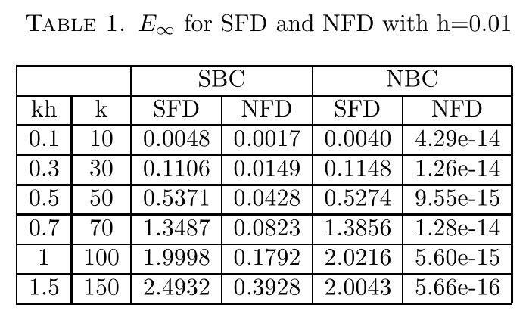
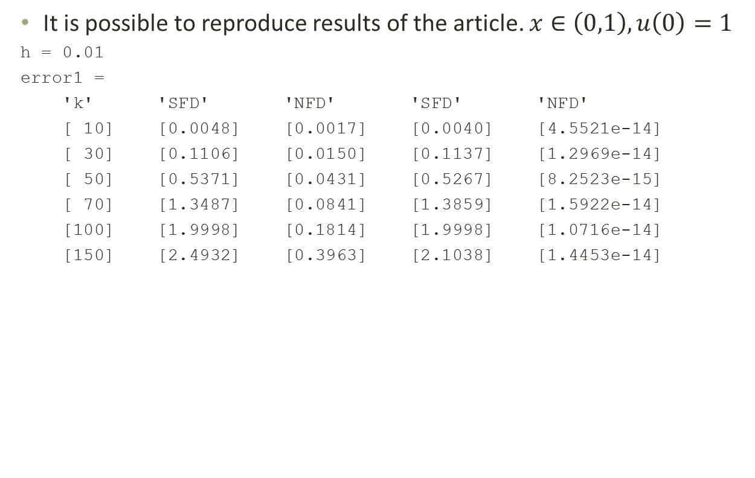
Results
It is possible to reproduce results of the article. $x∈\left(0,1\right), u\left(0\right)=1$
h = 0.01
error1 =
'k' 'SFD' 'NFD' 'SFD' 'NFD'
[ 10] [0.0048] [0.0017] [0.0040] [4.5521e-14]
[ 30] [0.1106] [0.0150] [0.1137] [1.2969e-14]
[ 50] [0.5371] [0.0431] [0.5267] [8.2523e-15]
[ 70] [1.3487] [0.0841] [1.3859] [1.5922e-14]
[100] [1.9998] [0.1814] [1.9998] [1.0716e-14]
[150] [2.4932] [0.3963] [2.1038] [1.4453e-14]

Slide 33

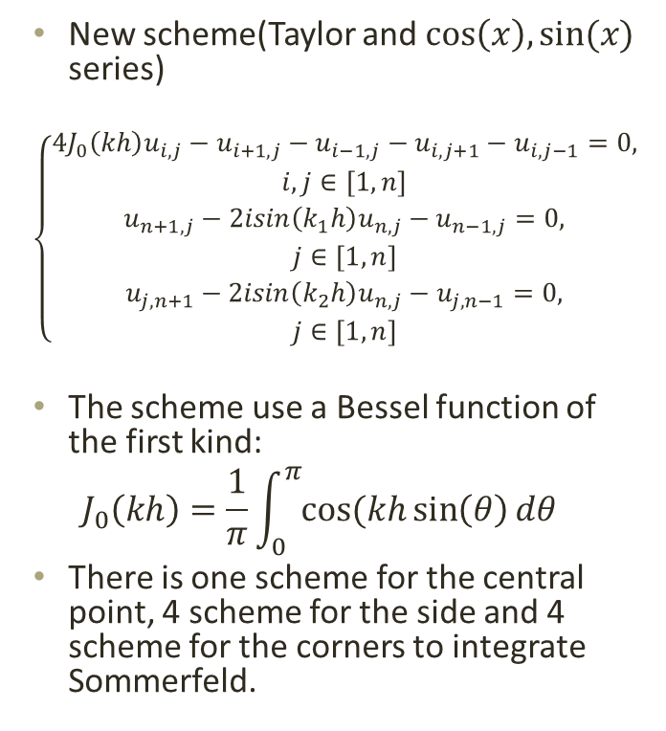
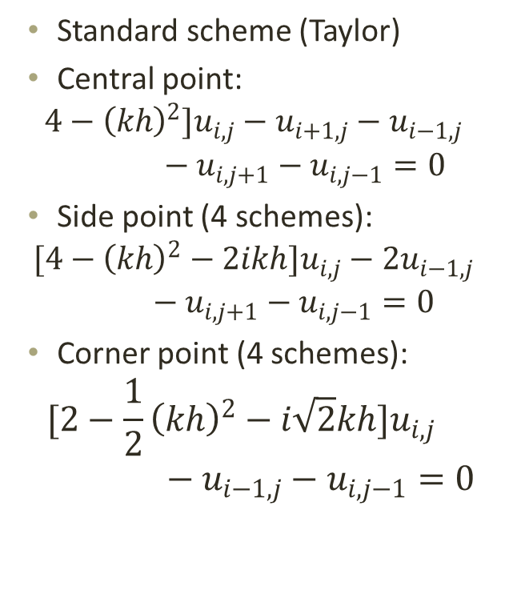
2D problem
$$\left\{\begin{aligned}∇^{2}u(x,y)+k^{2}u(x,y)=0, xε[a,b] \\ \frac{∂u(x,y)}{∂n}=iku\left(x,y\right) (Sommerfeld) \\ u\left(x,y\right)=α (Dirichlet)\end{aligned}\right.$$
Standard scheme (Taylor)
Central point:
$$4−{\left(kh\right)}^{2}]u_{i,j}−u_{i+1,j}−u_{i−1,j}−u_{i,j+1}−u_{i,j−1}=0$$
Side point (4 schemes):
$$[4−{\left(kh\right)}^{2}−2ikh]u_{i,j}−2u_{i−1,j}−u_{i,j+1}−u_{i,j−1}=0$$
Corner point (4 schemes):
$$[2−\frac{1}{2}{\left(kh\right)}^{2}−i\sqrt{2}kh]u_{i,j}−u_{i−1,j}−u_{i,j−1}=0$$
New scheme(Taylor and $cos\left(x\right), sin⁡(x)$ series)
$$\left\{\begin{aligned}4J_{0}\left(kh\right)u_{i,j}−u_{i+1,j}−u_{i−1,j}−u_{i,j+1}−u_{i,j−1}=0, \\ i,j∈\left[1,n\right] \\ u_{n+1,j}−2isin\left(k_{1}h\right)u_{n,j}−u_{n−1,j}=0, \\ j∈[1,n] \\ u_{j,n+1}−2isin\left(k_{2}h\right)u_{n,j}−u_{j,n−1}=0, \\ j∈[1,n]\end{aligned}\right.$$
The scheme use a Bessel function of the first kind:
$$J_{0}\left(kh\right)=\frac{1}{π}\int_{0}^{π}{cos⁡(kh\sin\left(θ\right)dθ}$$
There is one scheme for the central point, 4 scheme for the side and 4 scheme for the corners to integrate Sommerfeld.

Slide 34
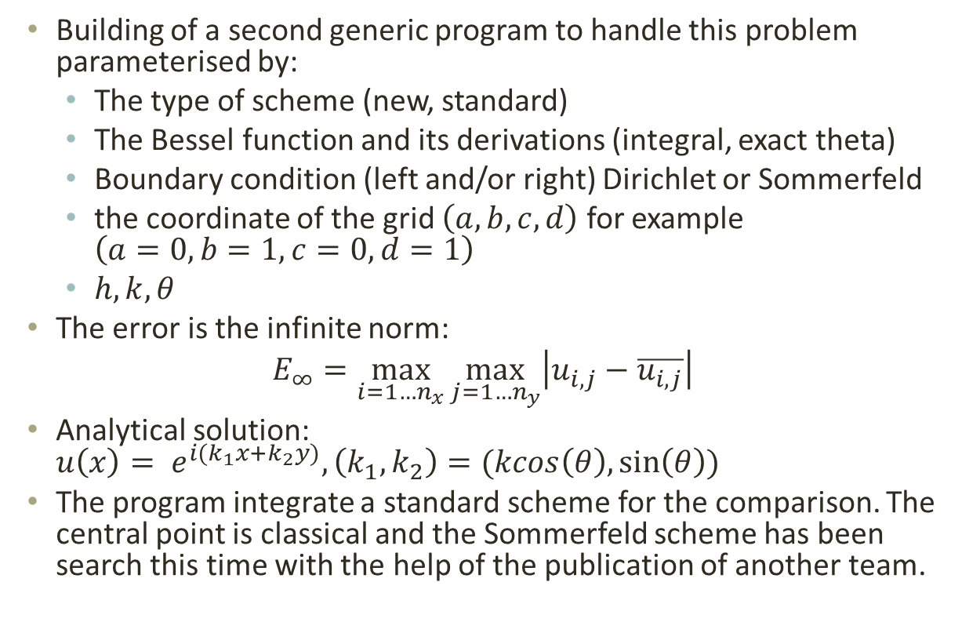
Program
Building of a second generic program to handle this problem parameterised by:
The type of scheme (new, standard)
The Bessel function and its derivations (integral, exact theta)
Boundary condition (left and/or right) Dirichlet or Sommerfeld
the coordinate of the grid $\left(a, b, c, d\right)$ for example $\left(a=0, b=1,c=0, d=1\right)$
$h, k, θ$
The error is the infinite norm:
$$E_{∞}=\max_{i=1…n_{x}}{\max_{j=1…n_{y}}\left|u_{i,j}−\overline{u_{i,j}}\right|}$$
Analytical solution: $u\left(x\right)= e^{i(k_{1}x+k_{2}y)}, \left(k_{1},k_{2}\right)=(kcos\left(θ\right),\sin\left(θ\right))$
The program integrate a standard scheme for the comparison. The central point is classical and the Sommerfeld scheme has been search this time with the help of the publication of another team.

Slide 35
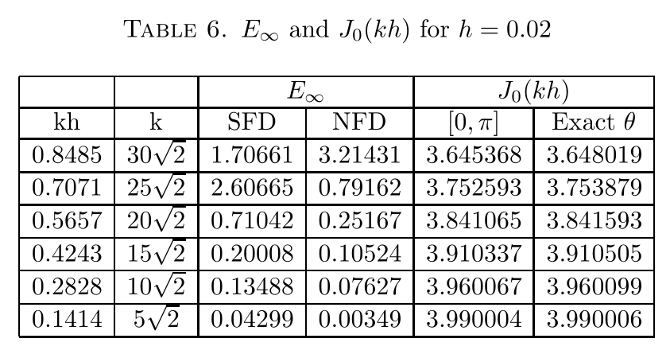
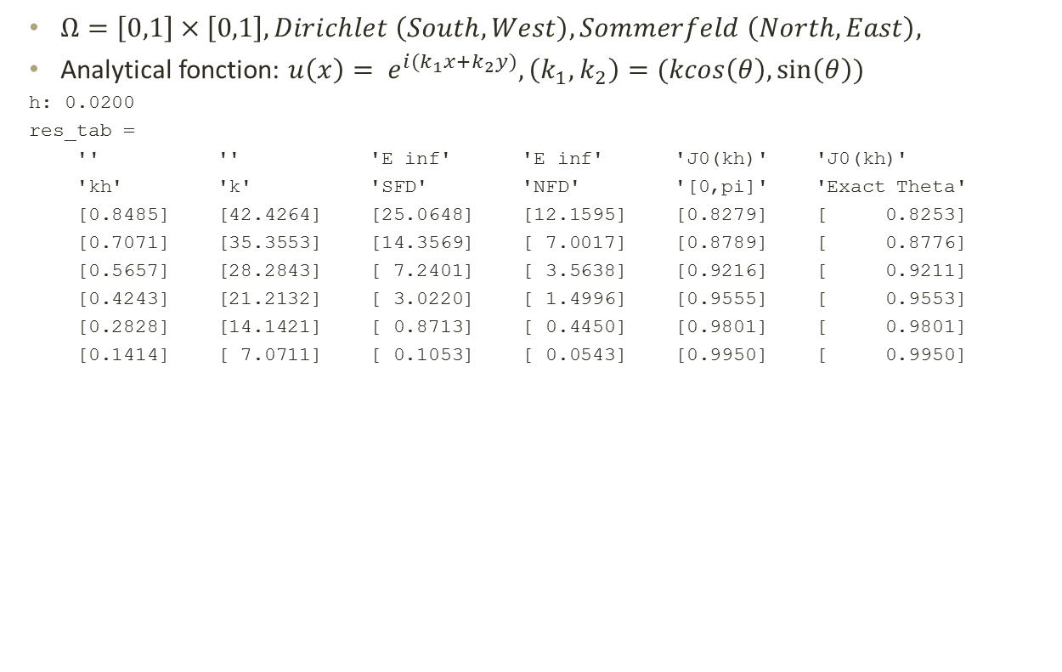
Results
$Ω=\left[0,1\right]×\left[0,1\right], Dirichlet \left(South, West\right), Sommerfeld \left(North, East\right),$
Analytical fonction: $u\left(x\right)= e^{i(k_{1}x+k_{2}y)}, \left(k_{1},k_{2}\right)=(kcos\left(θ\right),\sin\left(θ\right))$
h: 0.0200
res_tab =
'' '' 'E inf' 'E inf' 'J0(kh)' 'J0(kh)'
'kh' 'k' 'SFD' 'NFD' '[0,pi]' 'Exact Theta'
[0.8485] [42.4264] [25.0648] [12.1595] [0.8279] [ 0.8253]
[0.7071] [35.3553] [14.3569] [ 7.0017] [0.8789] [ 0.8776]
[0.5657] [28.2843] [ 7.2401] [ 3.5638] [0.9216] [ 0.9211]
[0.4243] [21.2132] [ 3.0220] [ 1.4996] [0.9555] [ 0.9553]
[0.2828] [14.1421] [ 0.8713] [ 0.4450] [0.9801] [ 0.9801]
[0.1414] [ 7.0711] [ 0.1053] [ 0.0543] [0.9950] [ 0.9950]

Slide 36
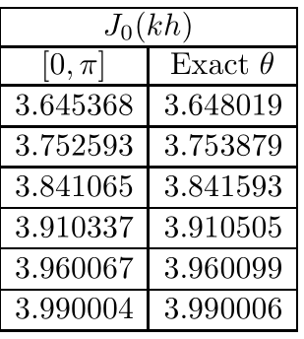

Result: Bessel
Three possible version (from the article):
$J_{0}\left(kh\right)= \frac{1}{π}\int_{0}^{π}{cos⁡(kh\sin\left(θ\right)dθ}$
$bessel_{integral\left(kh\right)}= \frac{1}{\left|b−a\right|}\int_{a}^{b}{cos⁡(kh\sin\left(θ\right)dθ}$
$exact_{theta}(kh)=cos⁡(kh\sin\left(θ\right)$
'kh' 'k' 'sum [0,pi]''exact theta''matlab'
[0.8485][42.4264][ 0.8279][ 0.8253][0.8279]
[0.7071][35.3553][ 0.8789][ 0.8776][0.8789]
[0.5657][28.2843][ 0.9216][ 0.9211][0.9216]
[0.4243][21.2132][ 0.9555][ 0.9553][0.9555]
[0.2828][14.1421][ 0.9801][ 0.9801][0.9801]
[0.1414][ 7.0711][ 0.9950][ 0.9950][0.9950]
'J0(kh)' 'J0(kh)' 'J0(kh)'
'sum [0,pi]''exact theta''matlab'
[ 3.3118][ 3.3013][3.3118]
[ 3.5154][ 3.5103][3.5154]
[ 3.6863][ 3.6842][3.6863]
[ 3.8220][ 3.8213][3.8220]
[ 3.9204][ 3.9203][3.9204]
[ 3.9800][ 3.9800][3.9800]

Slide 37

Results
$Ω=\left[0,1\right]×\left[0,1\right], Dirichlet \left(South, West\right), Sommerfeld \left(North, East\right),$
Analytical function: $u\left(x\right)= e^{i(k_{1}x+k_{2}y)}, \left(k_{1},k_{2}\right)=\left(kcos\left(θ\right),\sin\left(θ\right)\right)$
Different Bessel functions:
'kh' 'SFD' 'NFD-J0[0,pi]''NFD-J0[pi/8,3pi/8]''NFD - exact theta'
[42.4264] [25.0648][ 12.1595][ 4.4379][ 3.4574e-13]
[35.3553] [14.3569][ 7.0017][ 2.5483][ 4.1767e-13]
[28.2843] [ 7.2401][ 3.5638][ 1.2956][ 3.3647e-13]
[21.2132] [ 3.0220][ 1.4996][ 0.5450][ 3.8106e-13]
[14.1421] [ 0.8713][ 0.4450][ 0.1617][ 1.5676e-13]
[ 7.0711] [ 0.1053][ 0.0543][ 0.0197][ 1.4720e-12]
Full Dirichlet (all side, same problem)
'kh' 'SFD' 'NFD-J0[0,pi/2]''NFD-J0[pi/8,3pi/8]''NFD - exact theta'
[42.4264] [72.8404][ 19.0699][ 9.8070][ 1.0542e-12]
[35.3553] [22.1503][ 11.3565][ 3.1691][ 3.4689e-13]
[28.2843] [39.6772][ 9.8812][ 3.1514][ 6.9322e-13]
[21.2132] [40.1207][ 7.1648][ 3.0067][ 1.5089e-12]
[14.1421] [ 1.0660][ 0.5276][ 0.1920][ 1.1014e-13]
[ 7.0711] [ 0.2368][ 0.1198][ 0.0434][ 3.2334e-12]

Slide 38


Results
$Ω=\left[0,1\right]×\left[0,1\right], Dirichlet \left(South, West\right), Sommerfeld \left(North, East\right),$
Analytical function: $u\left(x\right)= e^{i(k_{1}x+k_{2}y)}, \left(k_{1},k_{2}\right)=\left(kcos\left(θ\right),\sin\left(θ\right)\right)$
Fix $k=\sqrt{2}×15$ but $θ∈\left[0,\frac{π}{2}\right], 20 values$

Slide 39

Search for theta
Least-square algorithm
Determine the coefficient of the linear system $Ax=b$ by calculating $J_{0}\left(kh\right) in \left[0,\frac{π}{2}\right]($is it $θ_{1}$ and $θ_{2}$ ? N.R).
Solve the system by GMRES (or another solver)
Take partial data from $x_{temp}$ (we take the two lines besides the Dirichlet boundaries in this study) and form the least square function: $f\left(x, θ\right)=\sum_{j=1}^{m}{(A\left(j\right)−x\left(j, θ\right))²}$ where $A(j)$ are the data from $x_{temp}$ and $x\left(j, θ\right)$ are the exact solution of plane wave $e^{ik(xcos\left(θ\right)+ysin\left(θ\right))}$with parameter $θ$.
Estimate $θ$using a non-linear least square (algorithm N.R) such as the Levenberg-Marquardt algorithm. Using different approximation in Step 4, we determine $θ_{1}$ and $θ_{2}$.
Update the coefficient of the system $Ax=b$ by re-computing $J_{0}\left(kh\right) in \left[θ_{1},θ_{2}\right].$
Repeat 2-5 until $θ$ converge.
The implementation has been done with Dirichlet given the problems in the formulation and the impossibility to find a good explanation for the Sommerfeld boundary.
It match $π/4$ within to iteration (that is in contradiction with the article). Other angles are much more problematic.

Slide 40
High order finite difference schemes
References:
Isaac Harari and Eli Turkel, "Accurate Finite Difference Methods for Time-Harmonic Wave Propagation," Journal of Computational Physics, vol. 119, 252-270 (1995), 1994.
Yogi Erlangga and Eli Turkel, "ITERATIVE SCHEMES FOR HIGH ORDER COMPACT DISCRETIZATIONS TO THE EXTERIOR HELMHOLTZ EQUATION," 2012.
Dan Gordon and Rachel Gordon, "Parallel solution of high frequency Helmholtz equations using high order finite difference schemes," Applied Mathematics and Computation, vol. 218 (2012) 10737–10754, 2012
Eli Turkel, Dan Gordon, Rachel Gordon, and Semyon Tsynkov, "Compact 2D and 3D sixth order schemes for the Helmholtz equation with variable wave number," Journal of Computational Physics, vol. 232 (2013) 272–287, 2012

Slide 41










5-points to 9-points stencil
$$A_{s}$$
$$A_{c}$$
$$A_{s}$$
$$A_{c}$$
$$A_{s}$$
$$A_{0}$$
$$A_{s}$$
$$A_{s}$$
$$A_{0}$$
$$A_{s}$$
$$A_{c}$$
$$A_{c}$$
$$A_{s}$$
$$A_{s}$$
$$A_{0}φ_{i,j}+A_{s}σ_{s}+A_{c}σ_{c}=0$$
$$σ_{s}=φ_{i,j+1}+φ_{i+1,j}+φ_{i,j−1}+φ_{i−1,j}$$
$$σ_{c}=φ_{i+1,j+1}+φ_{i+1,j−1}+φ_{i−1,j−1}+φ_{i−1,j+1}$$

Slide 42


Central & Sommerfeld Schemes
Order | $$A_{0}$$ | $$A_{s}$$ | $$A_{c}$$
2nd | $$−4+{\left(kh\right)}^{2}$$ | $$1$$ | $$0$$
4th | $$−\frac{10}{3}+{\left(kh\right)}^{2}(\frac{2}{3}+\frac{γ}{36})$$ | $$\frac{2}{3}+{\left(kh\right)}^{2}(\frac{1}{12}−\frac{γ}{72})$$ | $$\frac{1}{6}+{\left(kh\right)}^{2} γ/144$$
5th | $$−\frac{10}{3}+\frac{67}{90}{\left(kh\right)}^{2}+\frac{δ−3}{180}{\left(kh\right)}^{4}$$ | $$\frac{2}{3}+\frac{2}{45}{\left(kh\right)}^{2}+\frac{3−2δ}{720}{\left(kh\right)}^{4}$$ | $$\frac{1}{6}+\frac{7}{360}{\left(kh\right)}^{2}+\frac{δ}{720}{\left(kh\right)}^{4}$$
exact | $$4J_{0}(kh)$$ | $$−1$$ | $$0$$
Order | scheme
2nd | $$u_{n+1}+2ikh{ u}_{n}−u_{n−1}=0$$
6th | $$u_{n+1}+2iβh\left(1−\frac{β^{2}h^{2}}{6}+\frac{β^{4}h^{4}}{120}\right)u_{n}−u_{n−1}=0$$
exact | $u_{n+1,j}−2isin\left(k_{1}h\right)u_{n,j}−u_{n−1,j}=0$, $u_{j,n+1}−2isin\left(k_{2}h\right)u_{n,j}−u_{j,n−1}=0$

Slide 43
Redesign in OOP
A strong need for a more flexible type of program that would take into account:
Central schemes of different kind on two type of stencil
Different kind of Sommerfeld schemes
A need to combine Central Scheme/Boundary Condition easily
A more testable (and tested!) framework
Easy to use and to read from a user (and programmer) point of view
Clear computation of error
Easy and quick graphical representation
Export of resulting data

Slide 44

Central Scheme Module

Slide 45

Sommerfeld Scheme Module

Slide 46

Simulation Module

Slide 47

Reporting Module

Slide 48

Poisson revisited
% definition of the area we simulate in it
param.h = 0.125;%3 pt
param.a = 0.125;
param.b = 0.375;
param.c = 0.125;
param.d = 0.375;
param.m = (param.d - param.c)/param.h + 1;
param.n = (param.b - param.a)/param.h + 1;
% dirichlet function
param.dirichlet = @(x,y) poisson_dirichlet( x, y);
scheme = Poisson2D();
% define the solver
solver = @(A, b) A\b;
% solve the problem
ps = ProblemSolver(param, scheme, solver);
[ A, b, sol ] = ps.solve();
>> full(sol)
ans =
18.7500 37.5000 56.2500
12.5000 25.0000 37.5000
6.2500 12.5000 18.7500

Slide 49
Next Steps
Correct the actual framework to include correctly mixed and full Sommerfeld corners.
Analyse errors more deeply and compare them between various combinations of schemes (add more report classes…)
Include in the 2nd Order and 4th Order scheme (with and without Sommerfeld) a possibility to compute results with variable k (k may be a function of the position and parametrically depend on the angular frequency). . Analyse the ability of the scheme to handle position dependent refraction index.
Solve a problem with a digital anatomy-phantom defined by the position dependent refraction index.
Optional, if time permits, compare the high-frequency ray approximation to the full solution of the Helmholtz equation.
Wish: try to solve a basic Helmholtz equation with Finite Element Method

